Slide 1
Close Encounters
Art Play Melbourne (2015)
Yonetani workshop stimulus
In the Studio (August 2022)
Notes:
https://www.melbourne.vic.gov.au/arts-and-culture/artplay/Pages/artplay.aspx

Slide 2
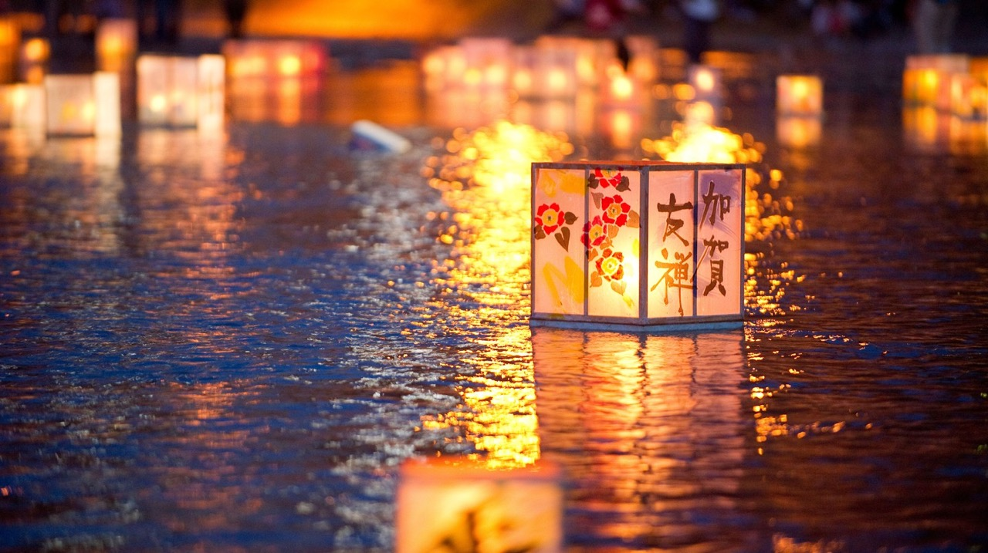
Image: ArtPlay Melbourne (2015)

Slide 3
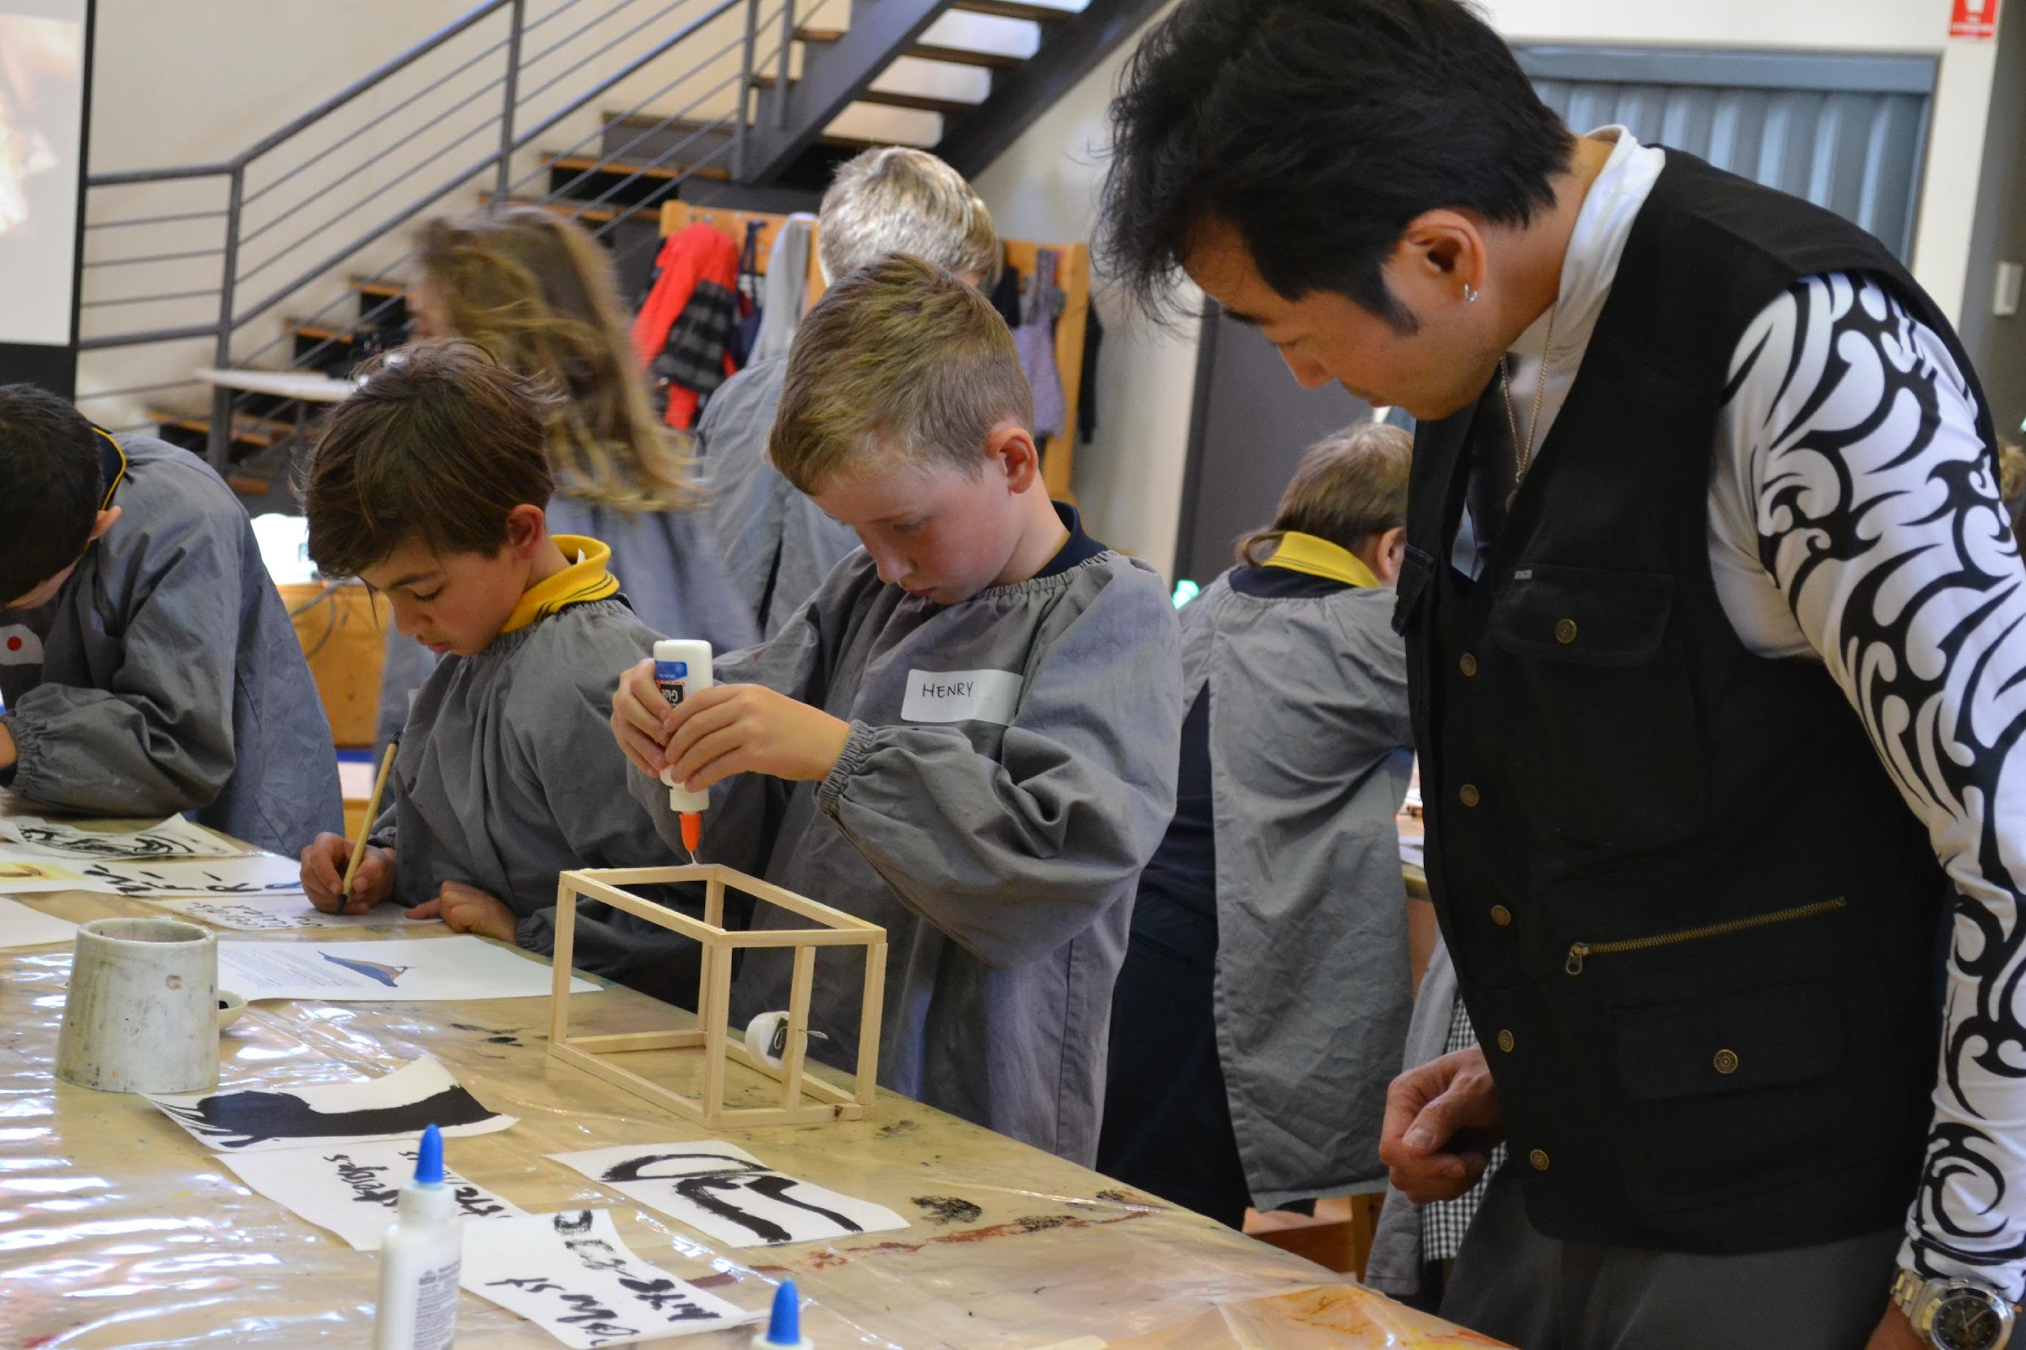
https://www.melbourne.vic.gov.au/arts-and-culture/artplay/Pages/artplay.aspx
Image: ArtPlay Melbourne (2015)

Slide 4
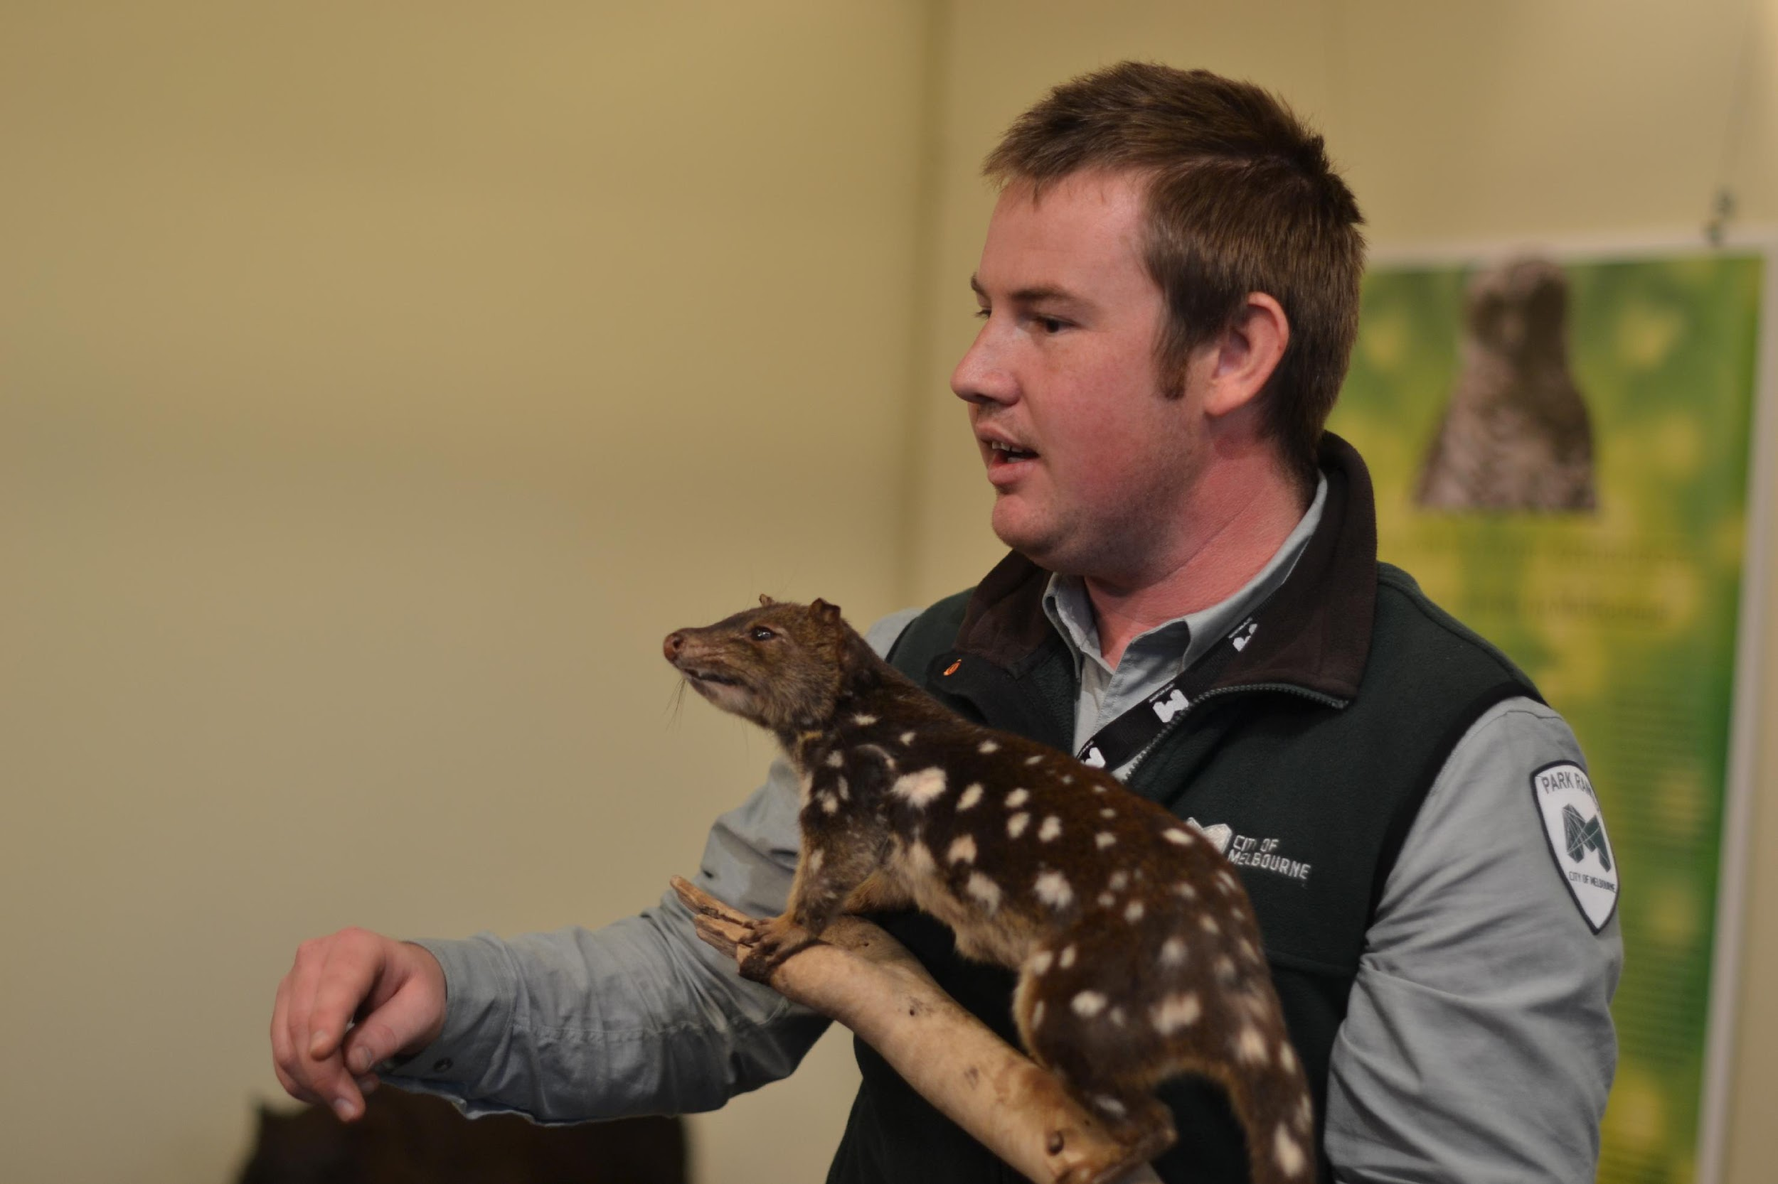
Image: ArtPlay Melbourne (2015)

Slide 5
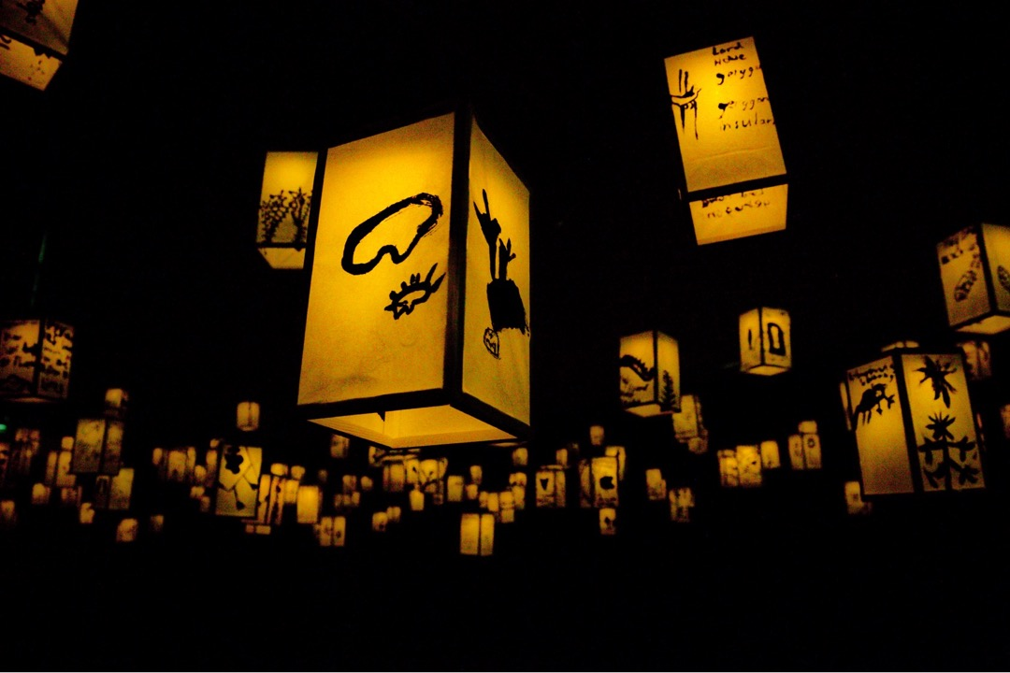
Image: ArtPlay Melbourne (2015)

Slide 6
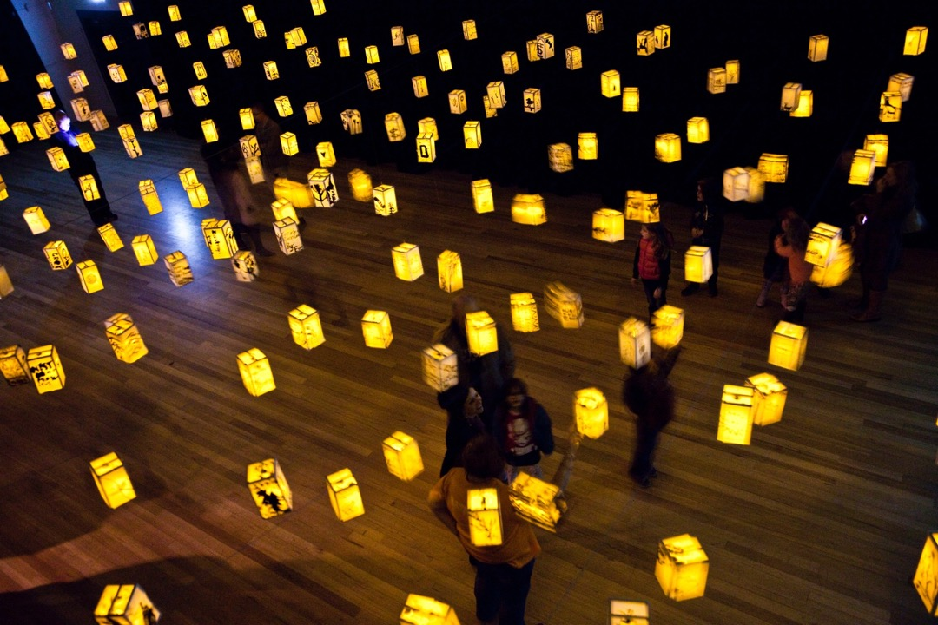
Image: ArtPlay Melbourne (2015)

Slide 7
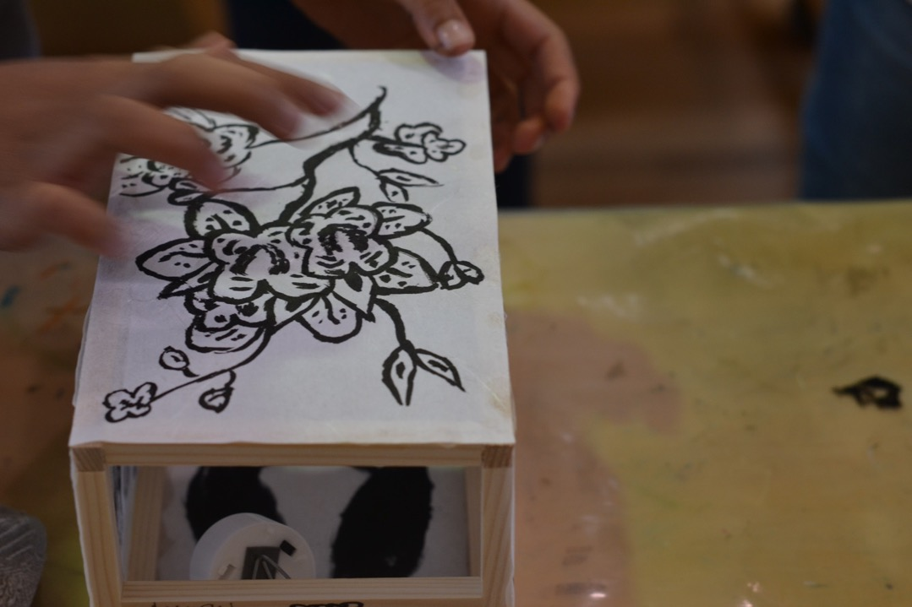
Image: ArtPlay Melbourne (2015)

Slide 8
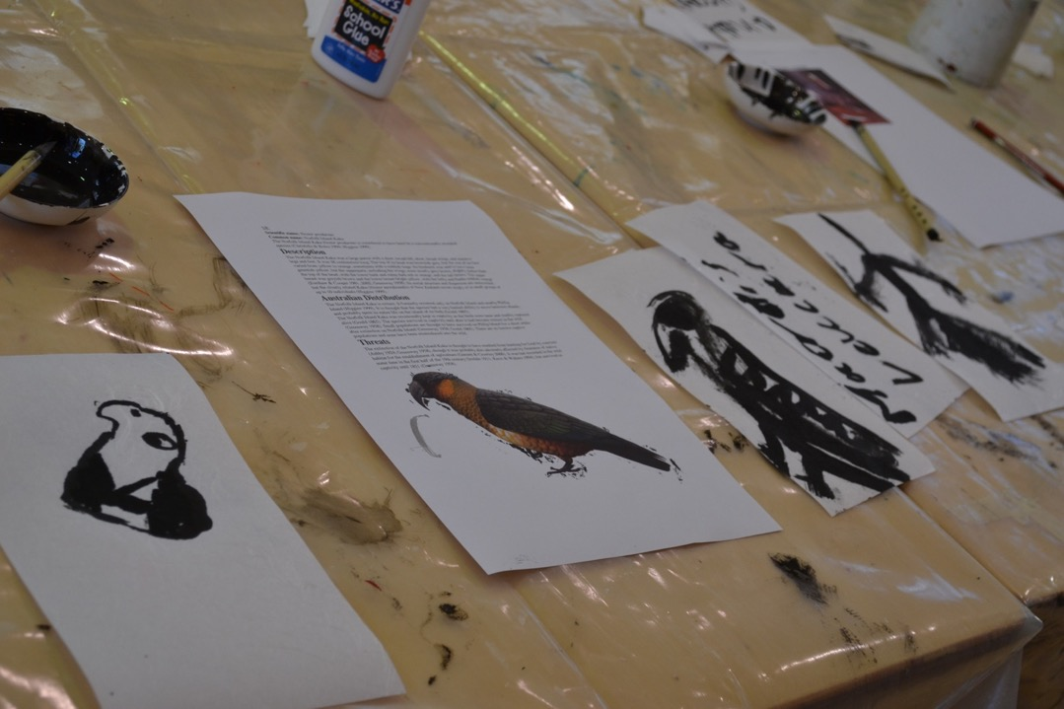
Image: ArtPlay Melbourne (2015)

Slide 9
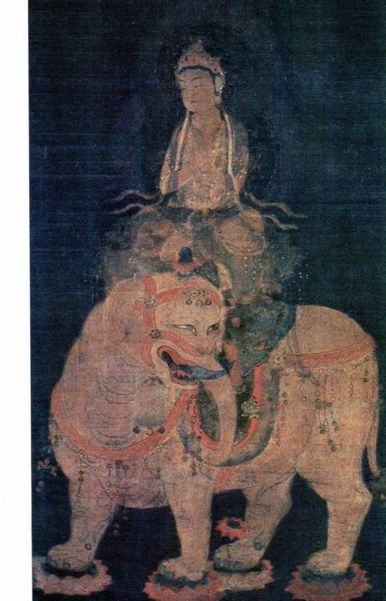
「普賢菩薩像」
Fugen Bodhisattva statue
Notes:
https://www.bridgemanimages.com/en/noartistknown/japan-the-bodhisattva-fugen-bosatsu-samantabhadra-hanging-scroll-painting-on-silk-heian-period-12th/nomedium/asset/3277562

Slide 10
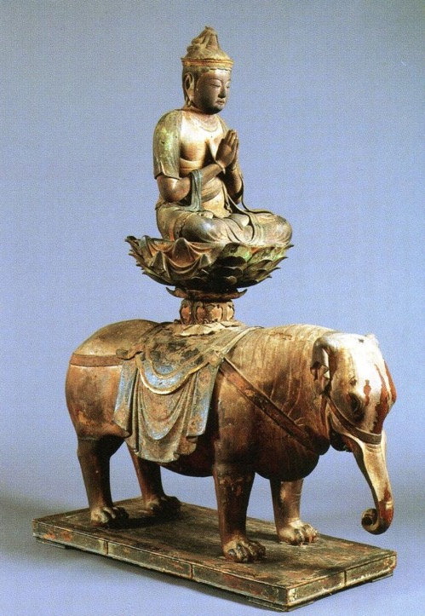
「普賢菩薩騎象像」 平安時代 （12世紀）制作 (東京・大倉集古館蔵）
Fugen Bosatsu equestrian statue
Heian period, 12th century
Collection of Okura Shukokan Museum, Tokyo
https://www.shukokan.org
Notes:
https://www.onmarkproductions.com/html/fugen.shtml

Slide 11
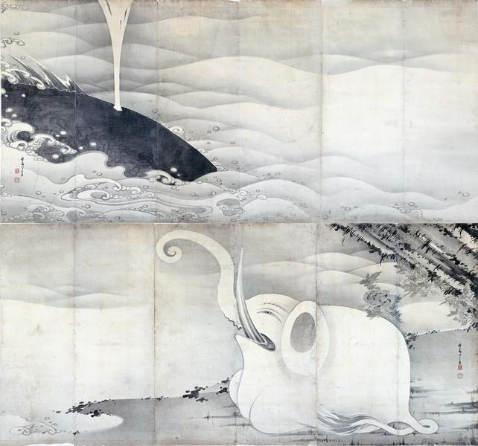
象と鯨図屏風
伊藤若冲筆
Elephant and whale screen
Ito Jakuchu
https://commons.wikimedia.org/wiki/File:Elephant_and_Whale_Screens_by_Ito_Jakuchu_(Miho_Museum)R.jpg
Itō Jakuchū (1716-1800), Public domain, via Wikimedia Commons

Slide 12
The Réunion ibis or Réunion sacred ibis (Threskiornis solitarius)
“Solitaires. These birds are so called because they always go alone. They are the size of a large Goose, and are white, with the tips of the wings and tail black. The tail feathers resemble those of an Ostrich; the neck is long, and the beak is like that of a Woodcock, but larger; the legs and feet like those of Turkeys. This bird has recourse to running, as it flies but very little.”
Dubois, 1674

Slide 13
Riversleigh Leaf-nosed Bat (Brachipposideros nooraleebus)
An Old World leaf-nosed bat from the Australian Miocene, was the first Australian fossil bat named and the first Brachipposideros species found outside of France. It was discovered at Riversleigh in northwest Queensland, where its bones have been found in the thousands. The Orange Leaf-nosed Bat Rhinonycteris aurantius, a close relative, still lives in caves in the area today.

Slide 14
Insecure Connections
“I think that the infosphere - the sphere of information - is going to impose itself on the geosphere. We are going to be living in a reduced world. The capacity of interactivity is going to reduce the world to nearly nothing. In fact, there is already a speed pollution, which reduces the world to nothing. In the near future, people will feel enclosed in a small environment. They will have a feeling of confinement in the world, which will certainly be at the limit of tolerability, by virtue of the speed of information. If I were to offer you a last thought - interactivity is to real space what radioactivity is to the atmosphere.”
Paul Virilio, Speed Pollution, 1996 Translated by James Der Derian with Lauren Osepchuk and Michael Degener

